Slide 1

Music DATA BASE

Slide 2

About Music PROJECT
In the music database project using SQL, I analyzed sales data to identify trends and insights. Key tasks included data cleaning, processing, and querying the database to find top-selling artists, popular genres, and customer spending patterns. I utilized SQL to join tables, aggregate data, and create views to extract valuable information, helping understand customer preferences and optimize music offerings.

Slide 3
INTRODUCTION
Hello, I’m Himanshu Jha, i have utilized my SQL queries with music database and also i prefmoned some question which is related to music data.

Slide 4
ques-1 who is the senior most employee based on their job title?

Slide 5
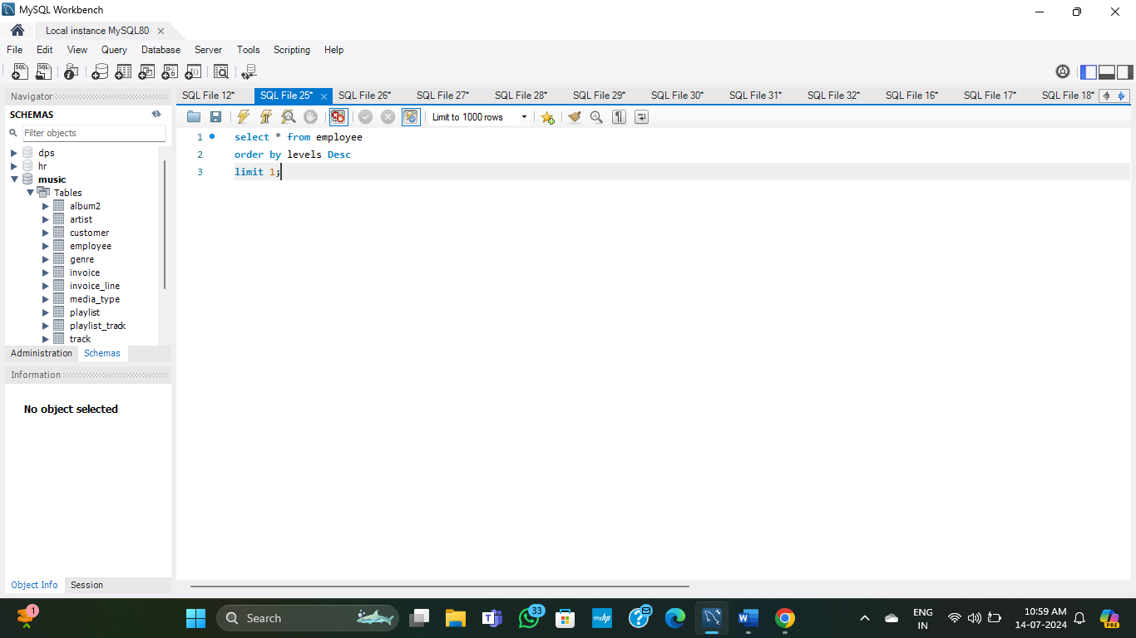

Slide 6
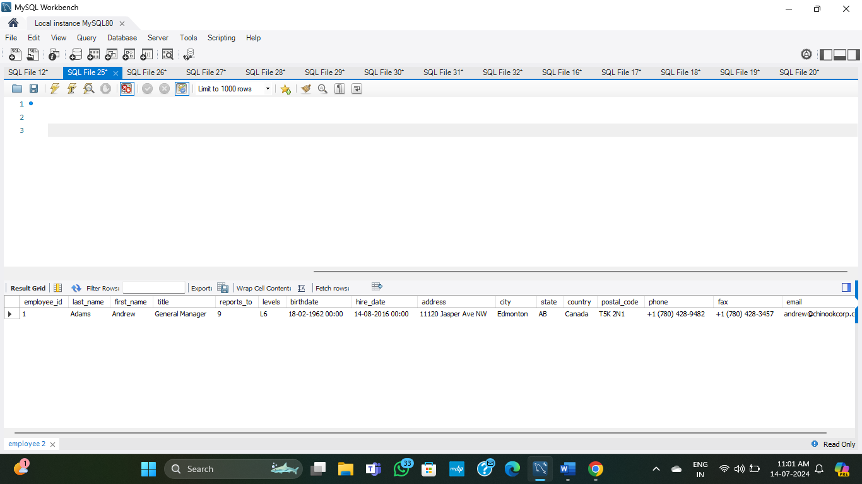
Output

Slide 7
que-2 which countries have the most invoices?

Slide 8
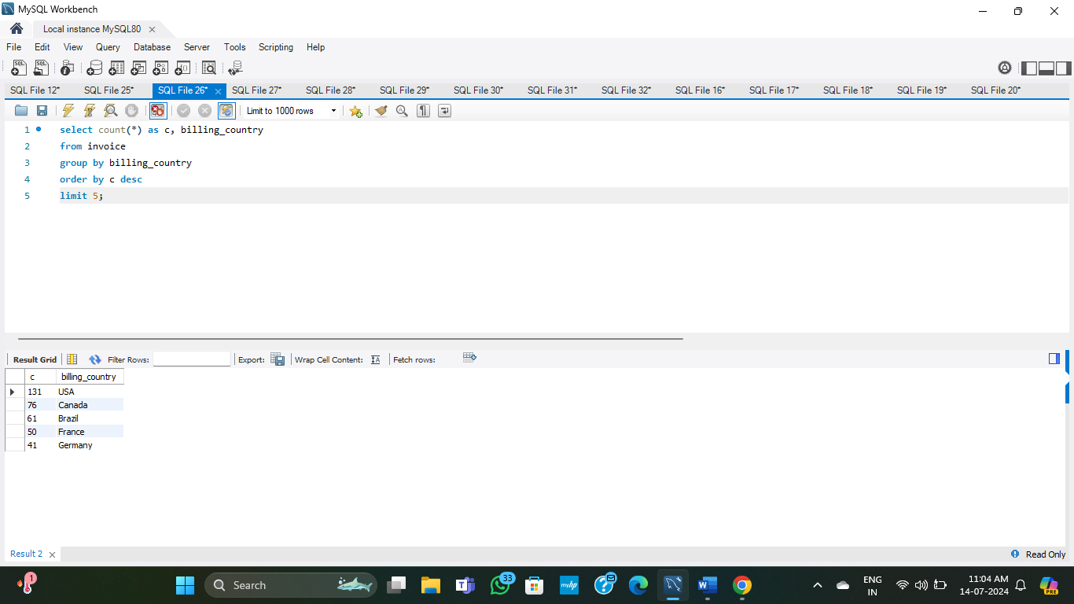
Input

Slide 9
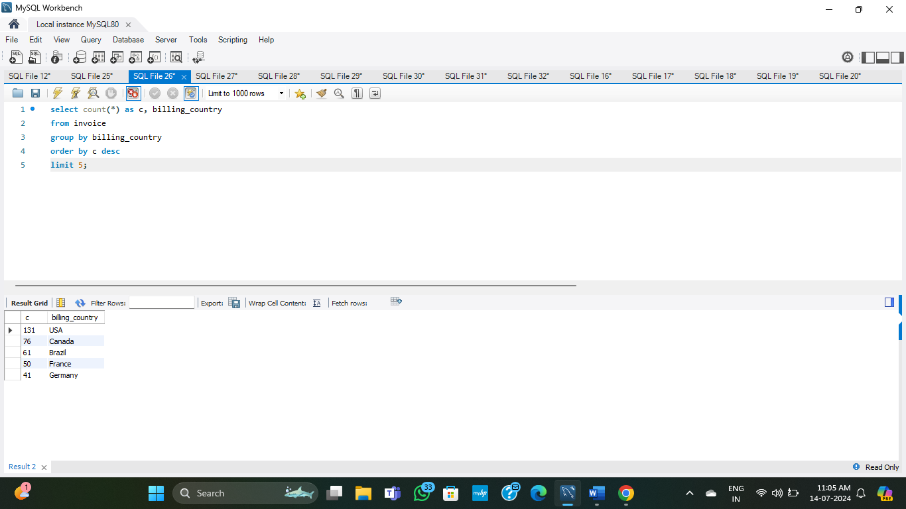
output

Slide 10
que-3 what are top 3 value of total invoice?

Slide 11
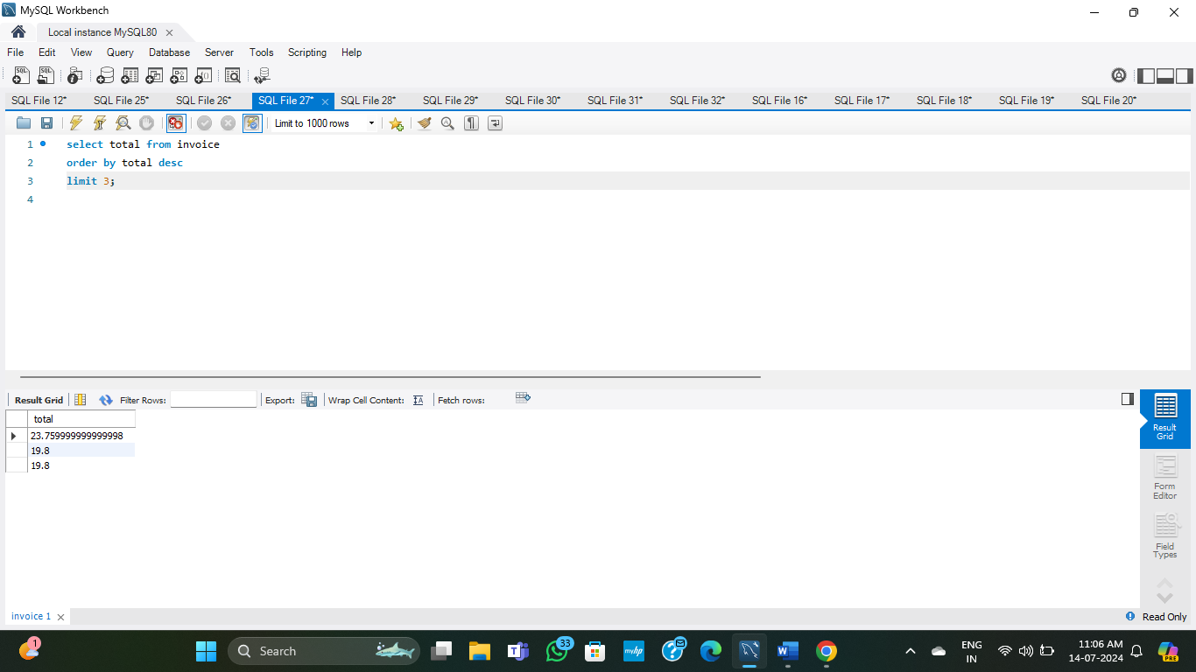
input

Slide 12

output

Slide 13
que-4 which country has the best customer? we would like to throw a promotional musical festival in the city we made the most money, write a query one city that has the highest sum of invoice totals? Return both the city name & sum of all invoice totals.

Slide 14
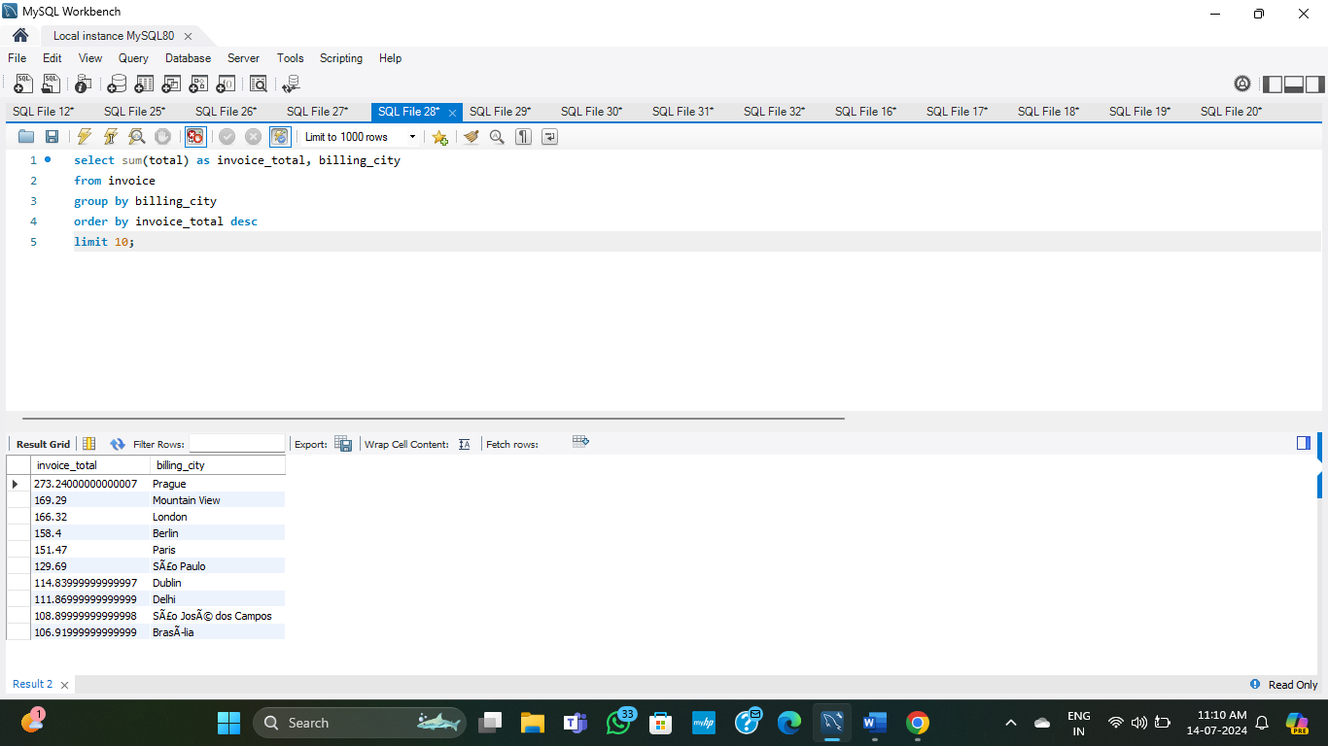
input

Slide 15
output

Slide 16
que 5 who is the best customer? The customer who has spent the most money will be declared the best customer. Write a query that returns the person who has spent the most money.

Slide 17
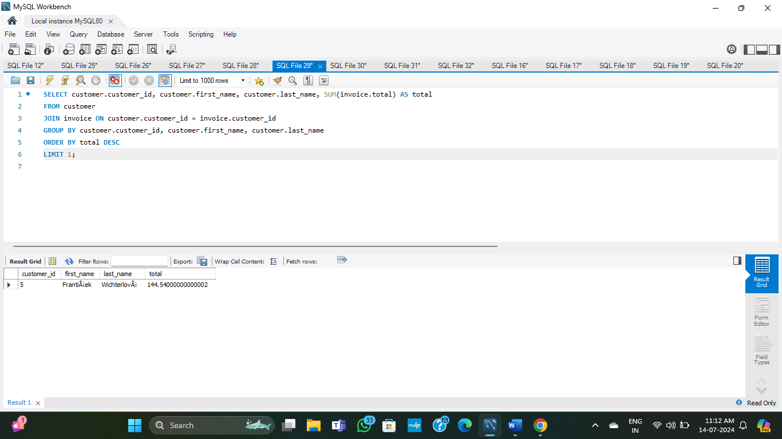
input

Slide 18

output

Slide 19
que-6 Write query to return the email, first name, last name, & Genre all of Rock music listeners. Return your list ordered alphabetically by email starting with A.

Slide 20
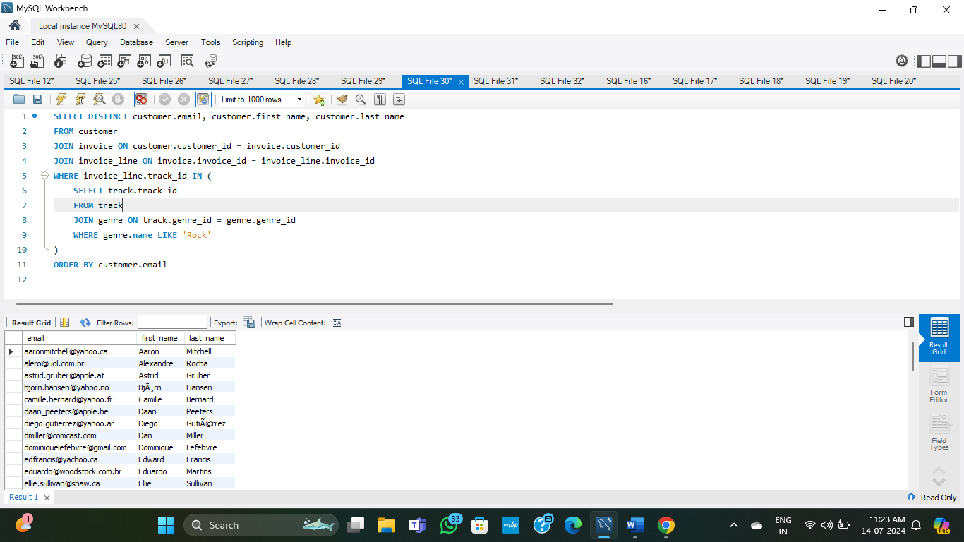
input

Slide 21
output

Slide 22
que 7 Let’s invite the artist who have written the most rock music in our dataset. Write a query that returns the artist name and total track count of the top 10 rock bands

Slide 23
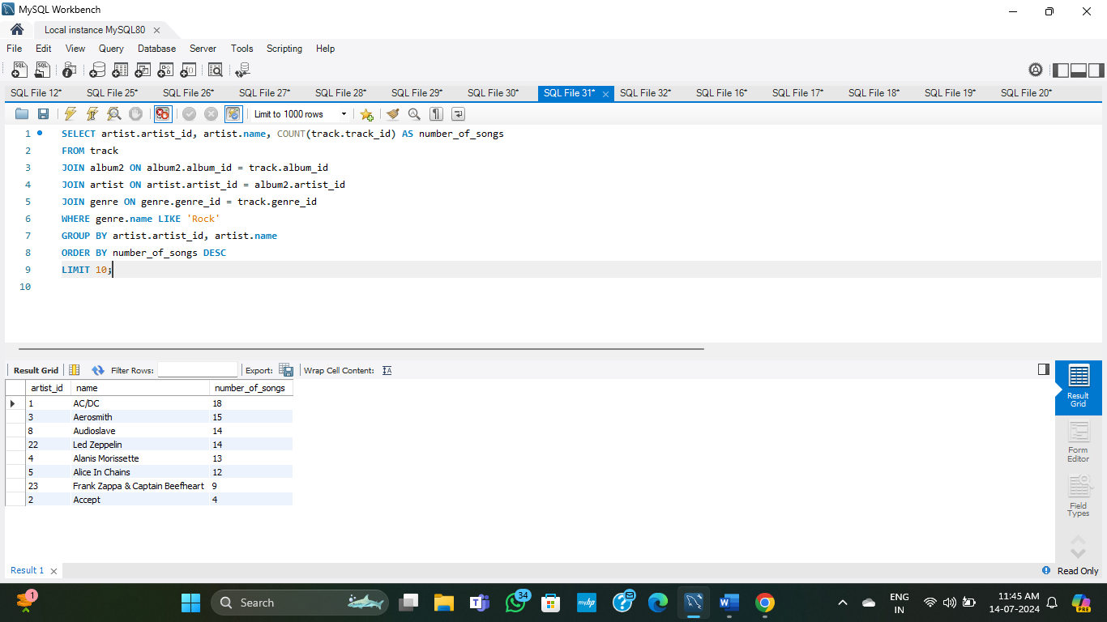
INPUT

Slide 24
output

Slide 25
que 8 Return all the track names that have a song length longer than the average song length. Return the name and milliseconds for each track. Order by the song length with the longest song listed first.

Slide 26
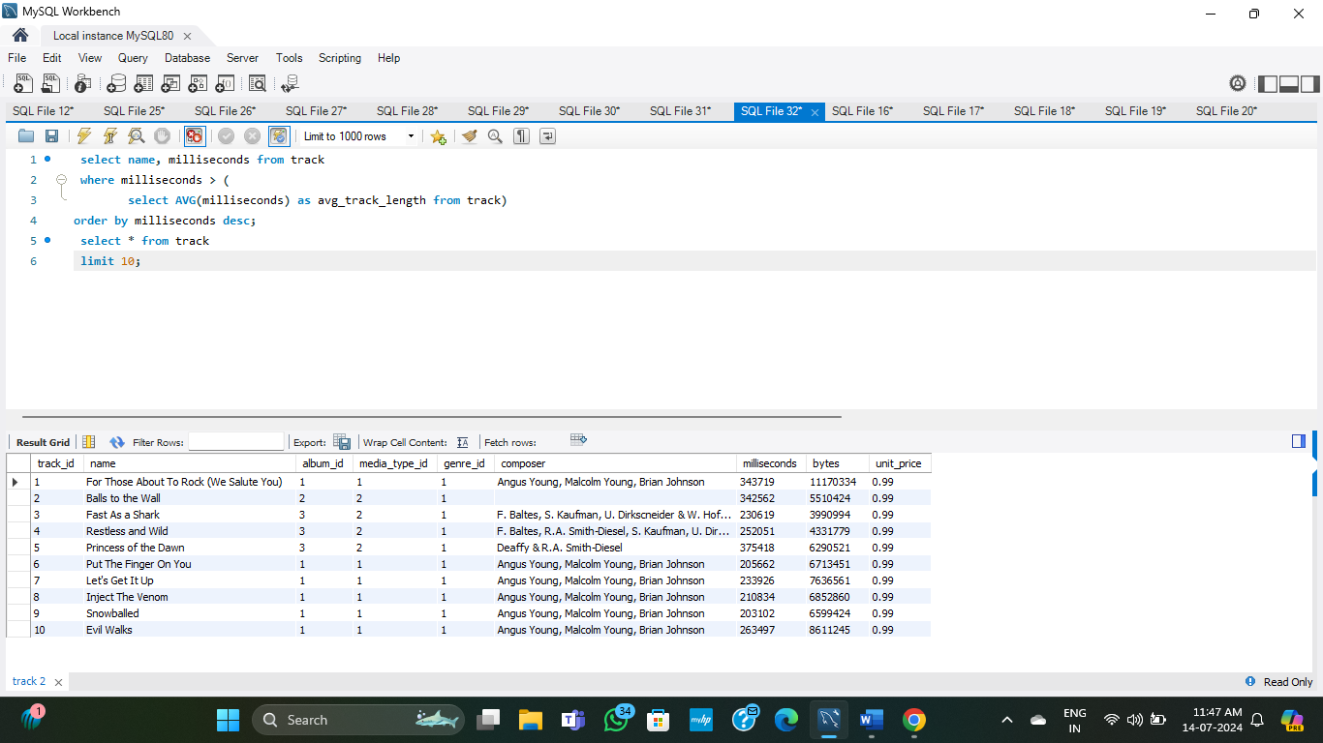
input

Slide 27
output

Slide 28
Ques-9 Find how much amount spent by each customer on artists? Write a query to return customer name, artist name and total spent.

Slide 29
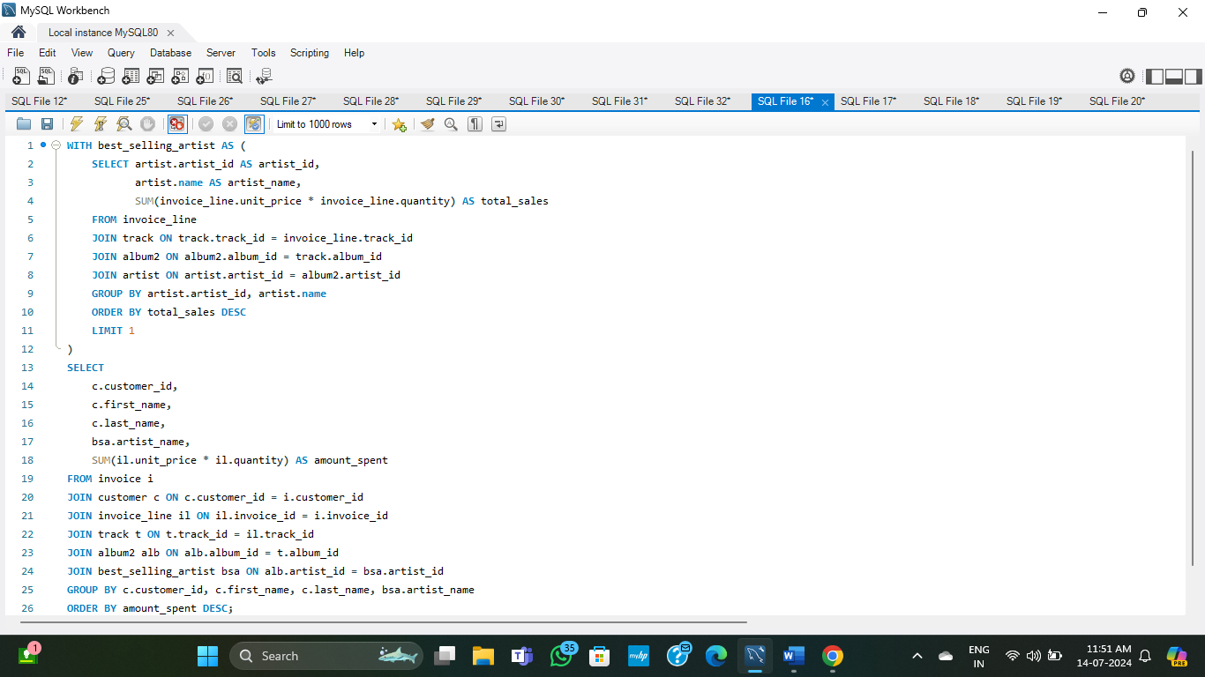
input

Slide 30
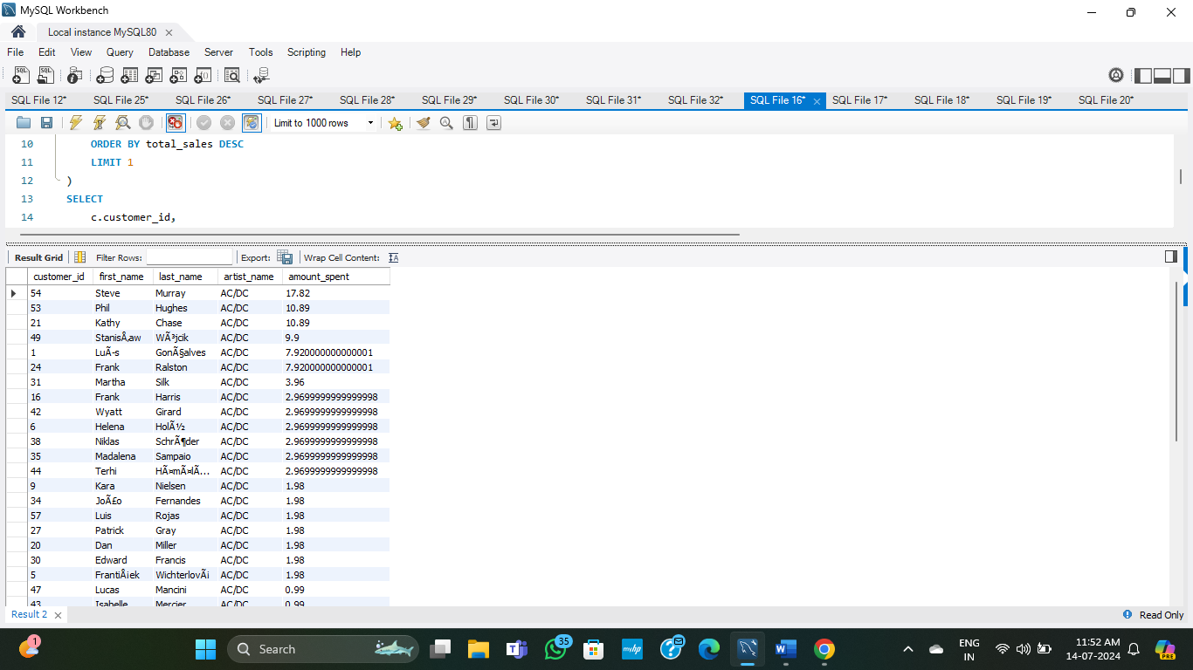
output

Slide 31
ques-we want to find out the most popular music genre for each country. We determine the most popular genre with the highest amount of purchase. Write a query that return each country along with the top Genre. For countries where the maximum number of purchases is shared return all genres.

Slide 32
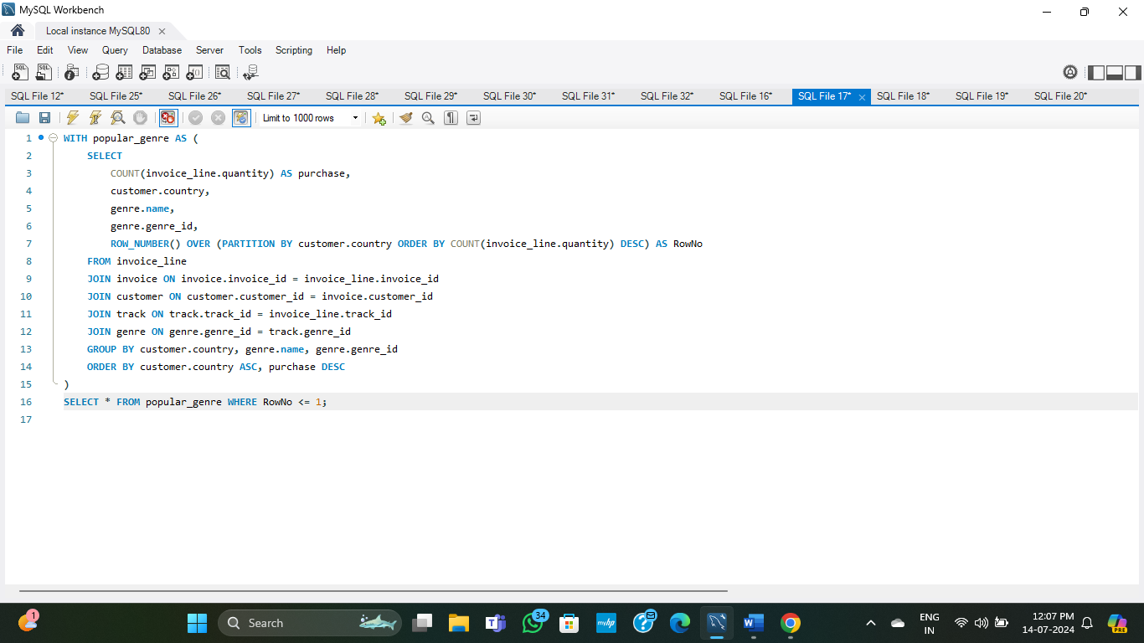
input

Slide 33
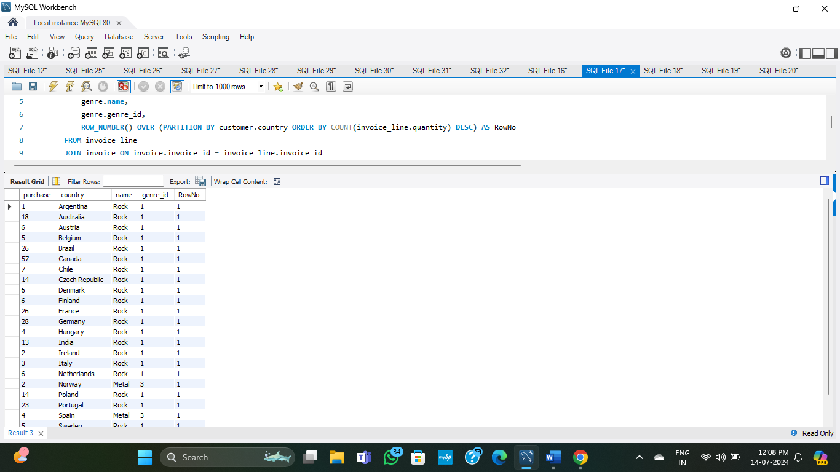
output

Slide 34
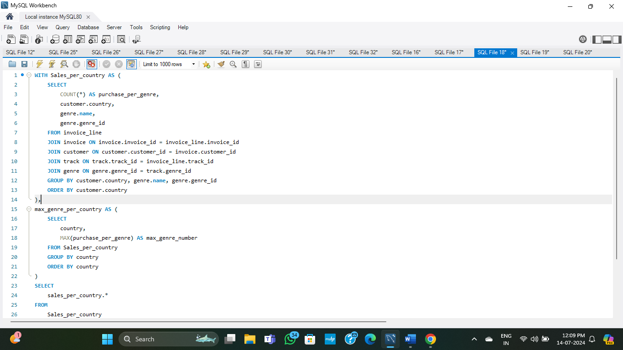
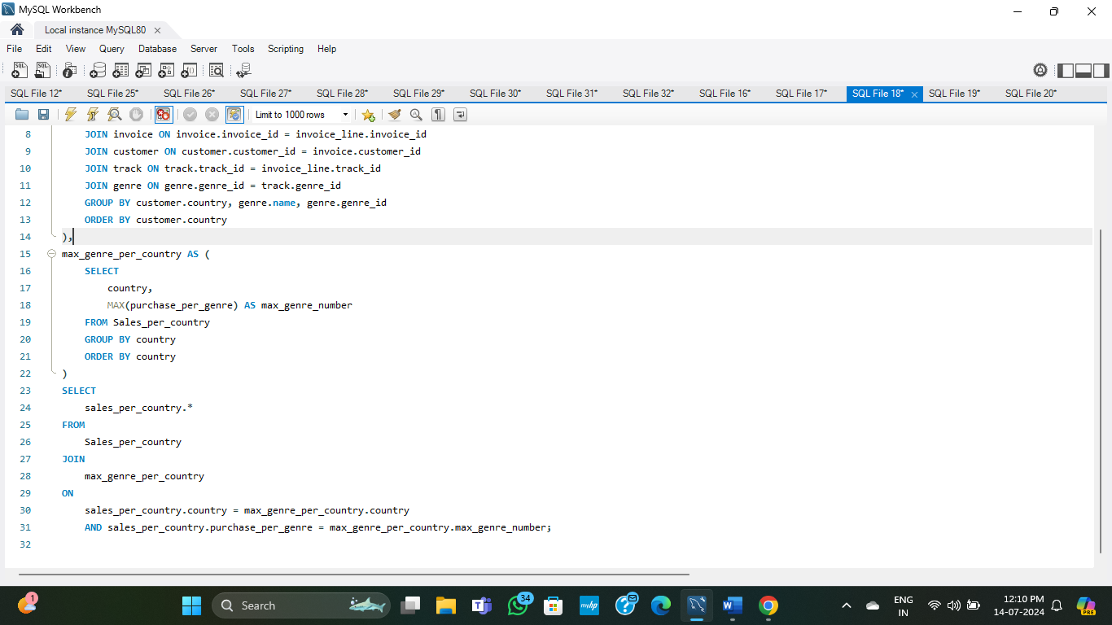

Slide 35
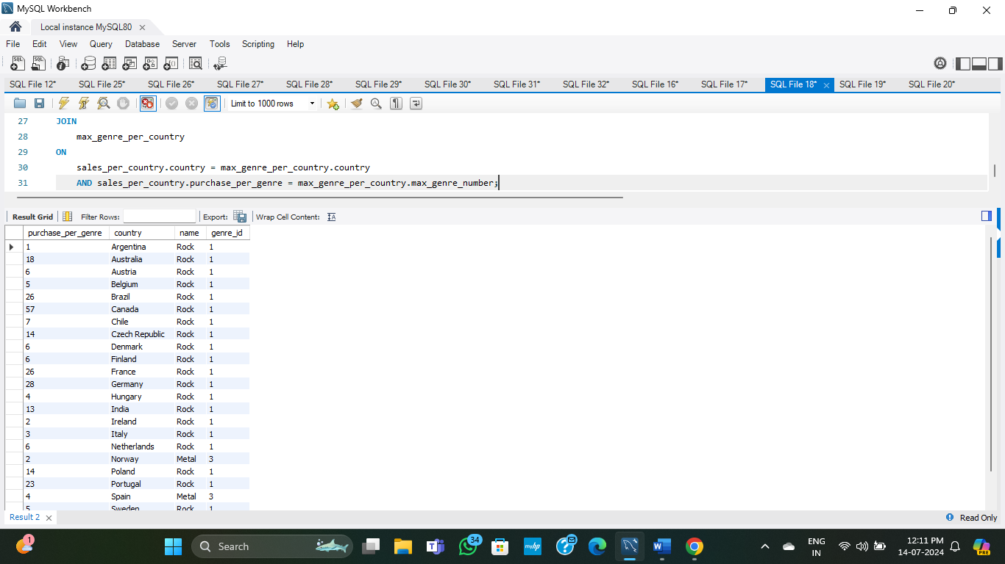
output

Slide 36
11 write a query that determines the customer that has spent the most on music for each country. Write a query that returns the country along with the top customer and how much they spent. For countries where the top amount spent is shared, provide all customers who spent this amount.

Slide 37
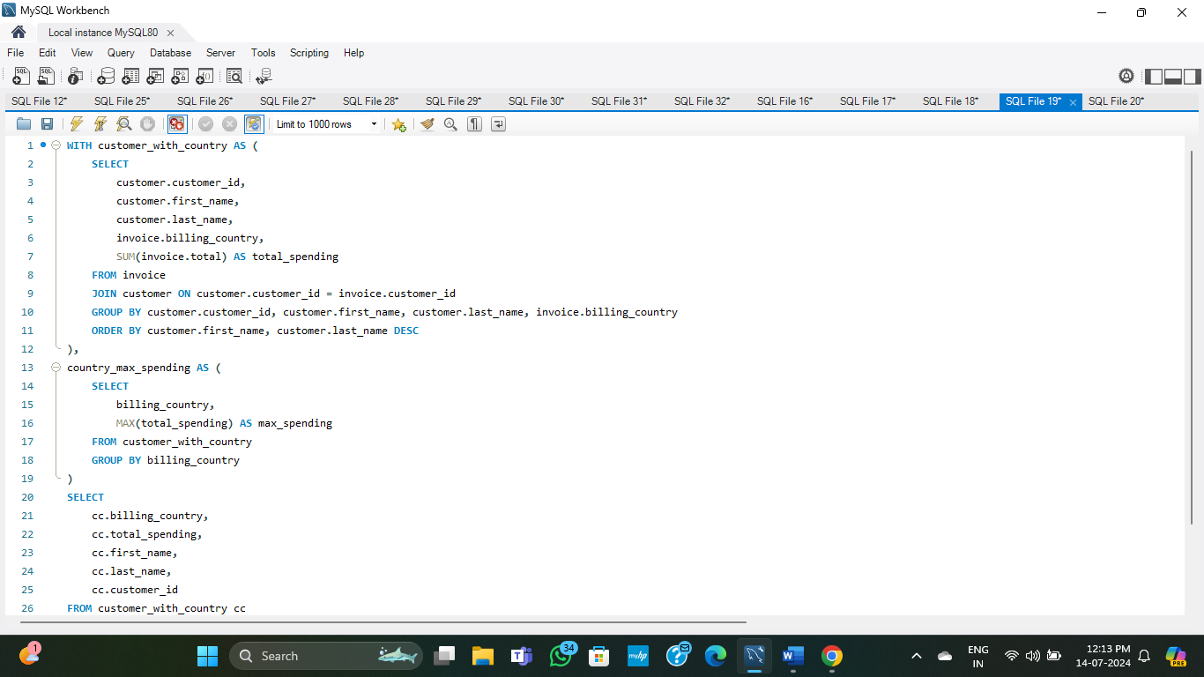
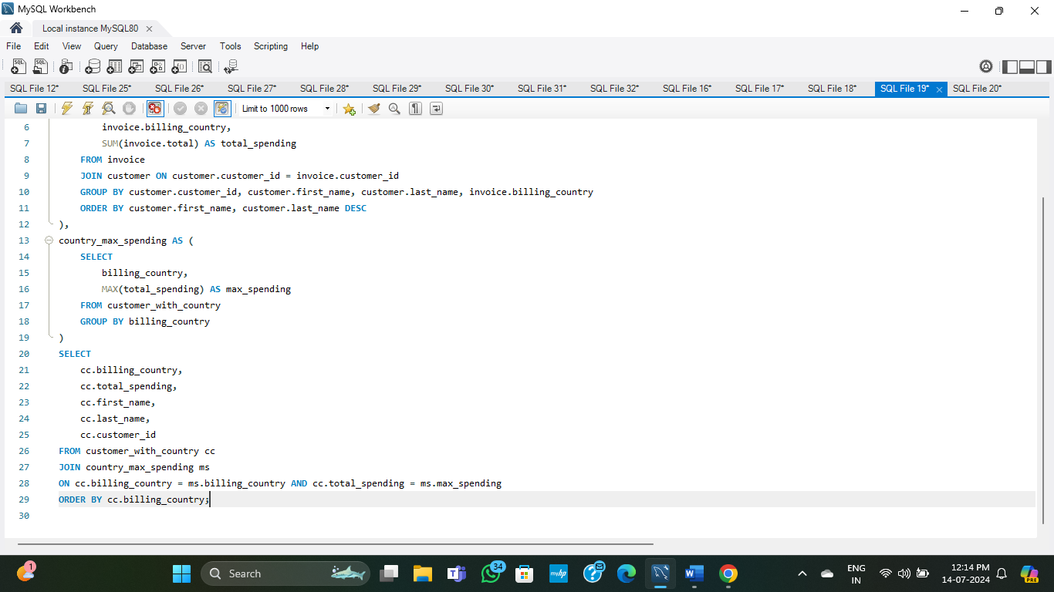
input

Slide 38
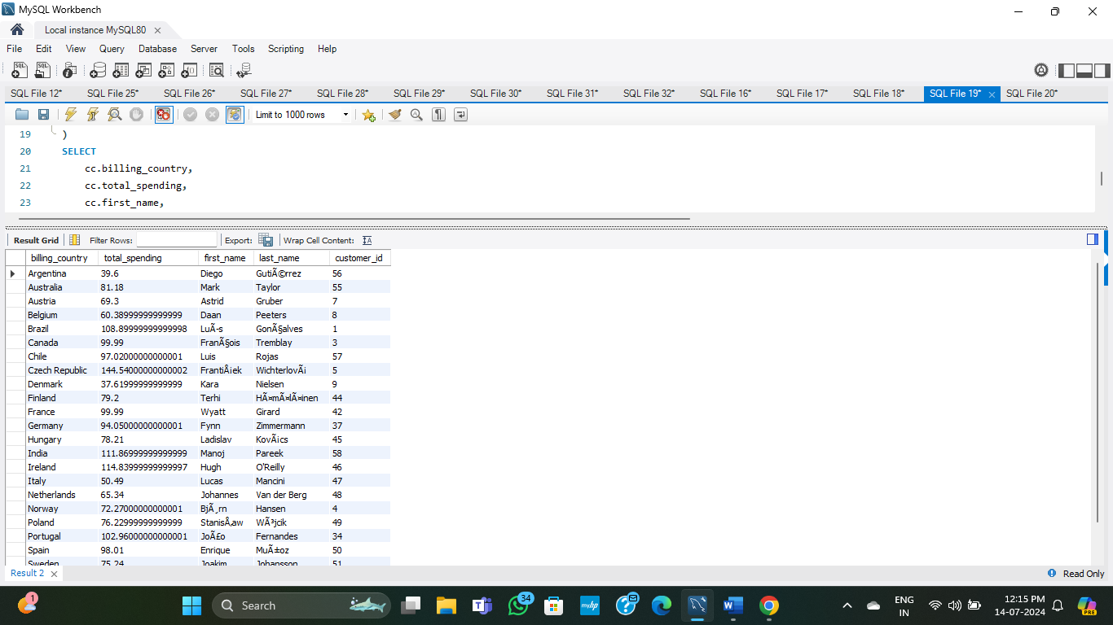
output

Slide 39
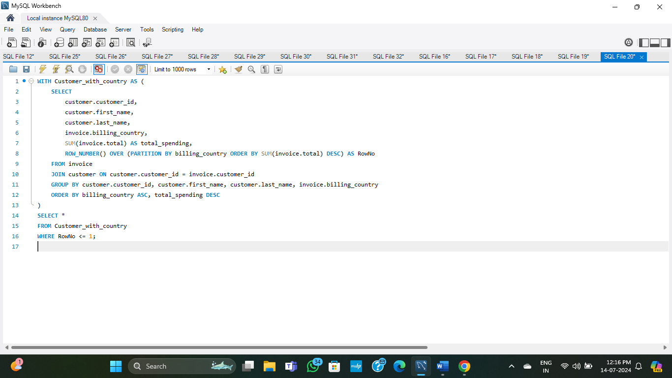
recursive method

Slide 40
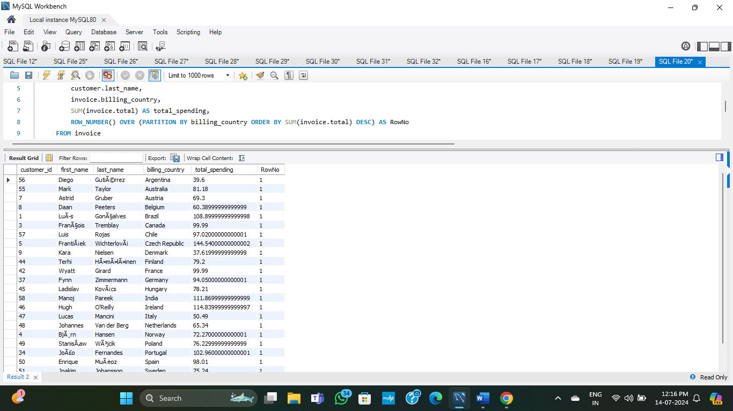
output

Slide 41
Thank You

